Slide 1



Fraud Detection
SIC 6
Notes:
Note:
1

Slide 2
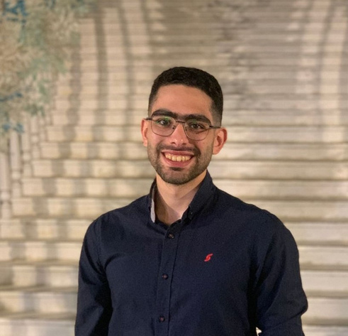
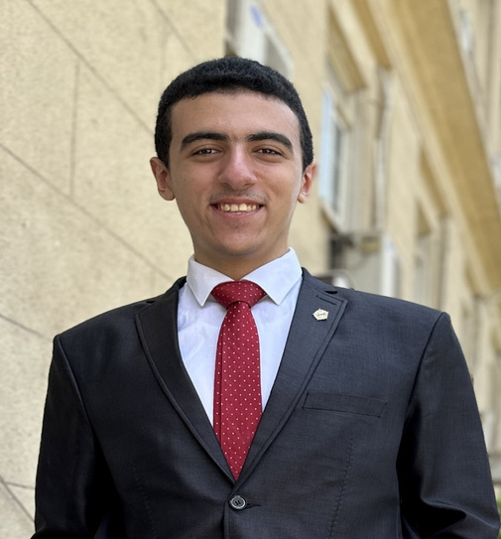

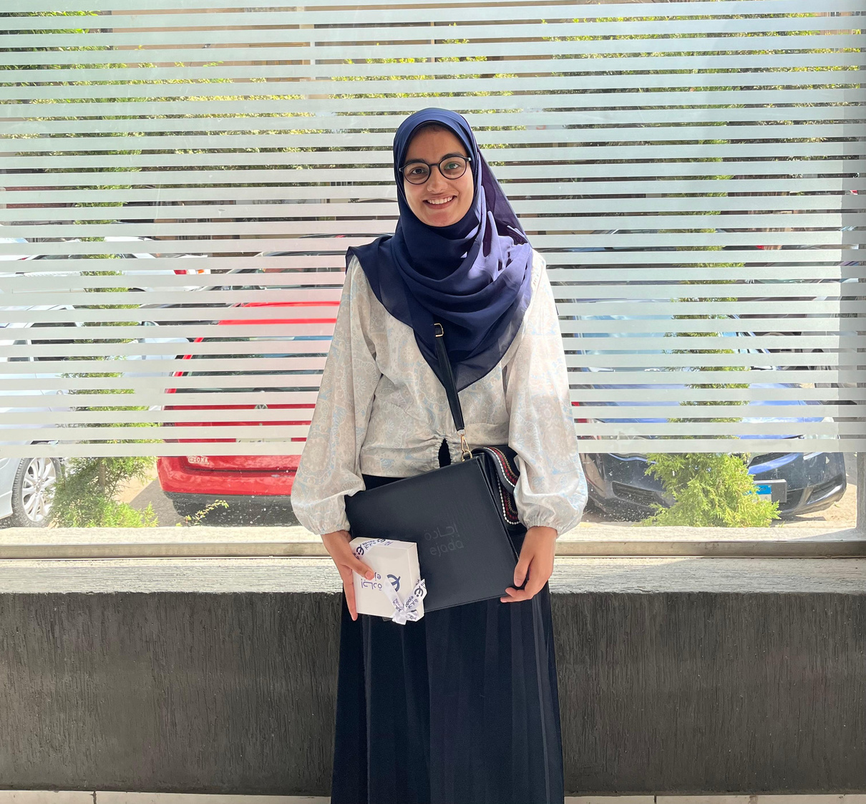
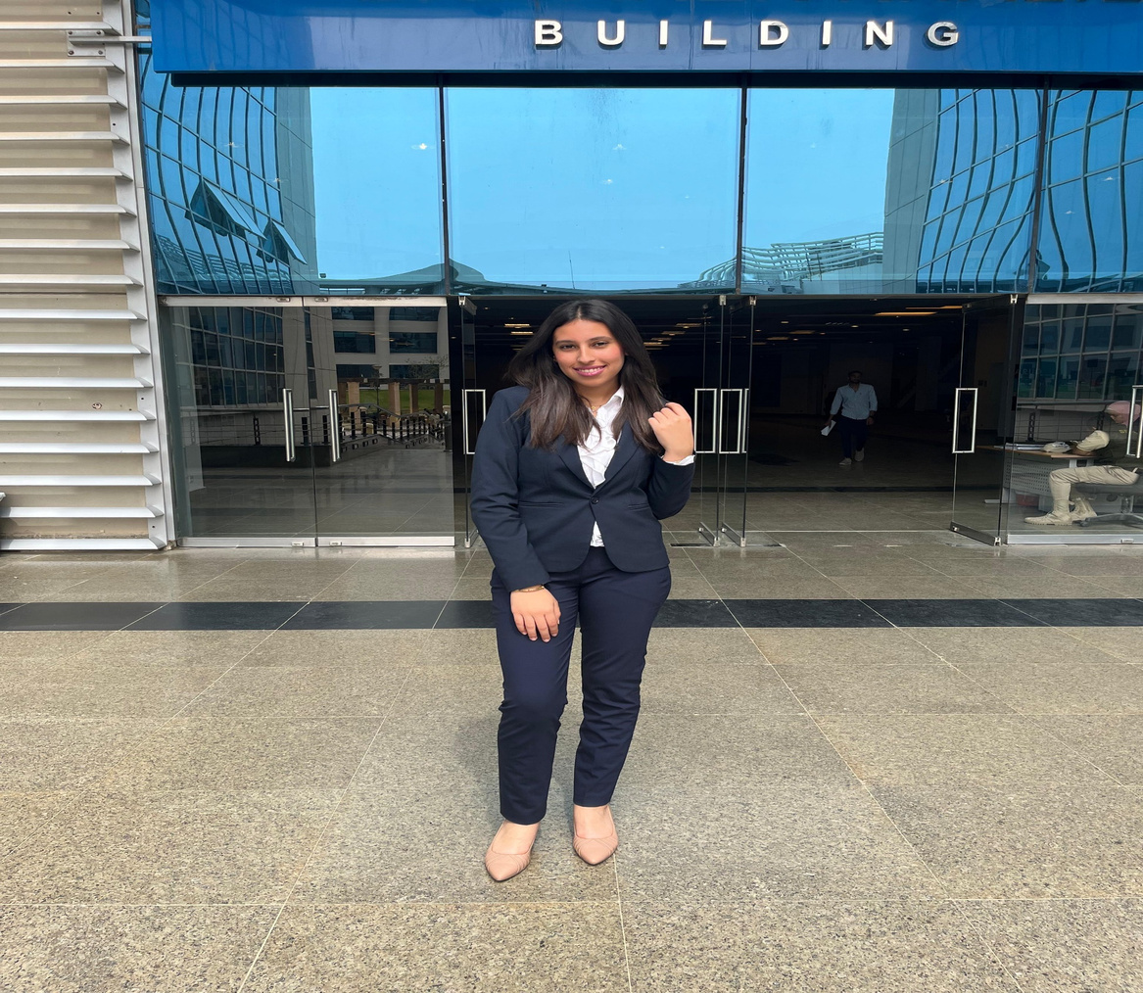
OUR TEAM
Karim Sherif
Mohamed Walid
Eman Abdelsayed
Salma Mamdoh
Jana Tamer
Samsung Innovation campus

Slide 3
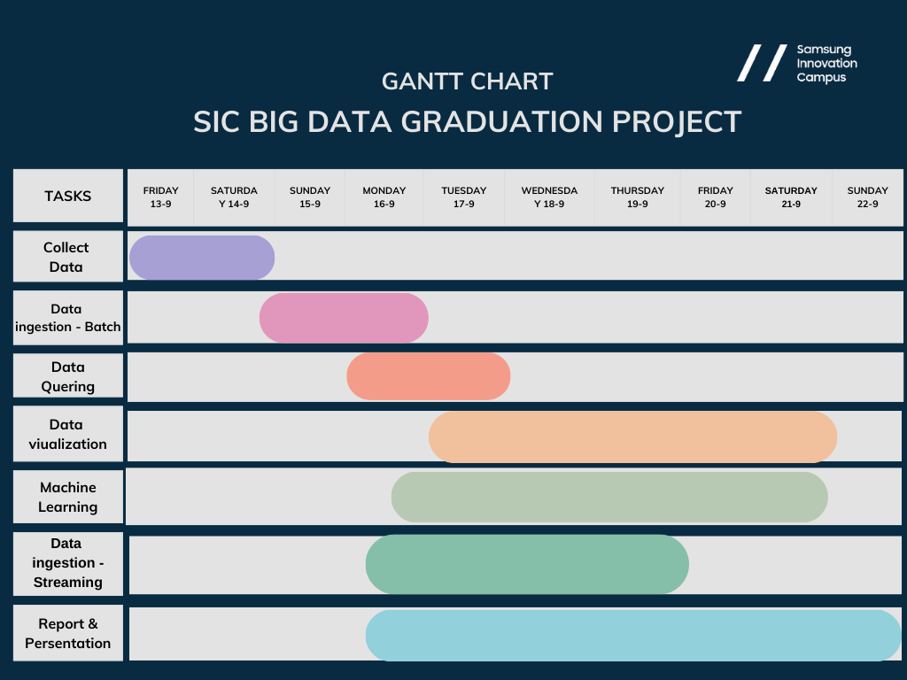

Slide 4






Overview
Introduction
04
Business goals
05
Solution Architecture
07
Queries
08
Machine Learning
15
Visualizations
39
Recomendations
43
Samsung Innovation campus

Slide 5


Out of the billions of digital transactions happening each day,
can you guess how many are fraudulent and what tools can stop them in their tracks?
top them in their tracks?
Samsung Innovation campus
Financial fraud is a growing threat in the digital age, costing the global economy over $5 trillion annually, with more than 3 billion transactions processed daily. Our project tackles this challenge by creating a powerful system that detects suspicious transactions within these massive datasets. Leveraging cutting-edge tools like Hadoop, Spark, Hive, and machine learning, we’ll identify fraud patterns with up to 95% accuracy, reduce false positives, trigger instant alerts, and visualize insights for smarter, faster decision-making—arming organizations to stay one step ahead of fraud, protect their reputation, and ensure regulatory compliance.

Slide 6



Business Goals
Use the best tools to stop fraud.
Make customers feel safe and secure.
Catch fraud quickly and act fast.
Stay on top of security rules and regulations.
Save money by reducing fraud losses.
Samsung Innovation campus

Slide 7

Dataset Overview:
Simulated credit card transactions from 1000 customers (2019-2020).
Includes transaction details (amount, date, merchant, location).
Contains customer information (name, gender, job, city population).
Fraud flag identifies whether a transaction is fraudulent.
Generated using Sparkov tool for realistic behavior modeling.
Samsung Innovation campus

Slide 8
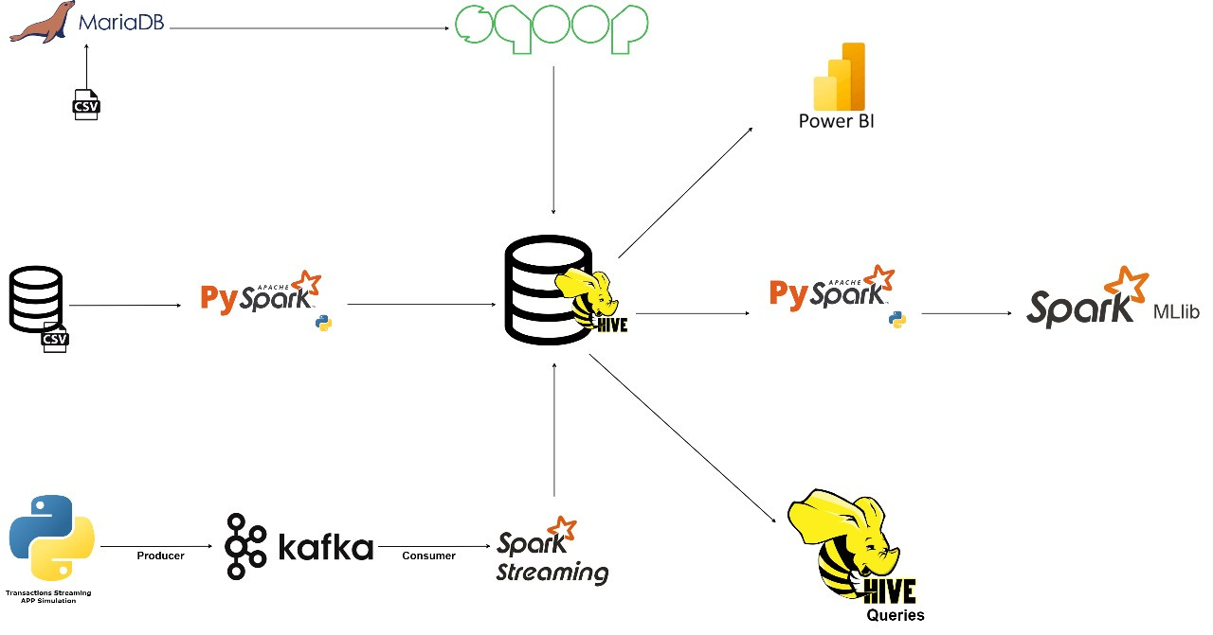
Solution Architecture
Samsung Innovation campus

Slide 9



Querying &
VISUALIZATION
Using HIVE SQL & Power Bi
Notes:
In our analysis, we used Hive SQL to query the dataset and explore patterns of fraud transactions. We ran a total of 17 queries, each designed to uncover specific insights. After running these queries, we utilized Hue for data visualization, to better interpret the results.
and lets explore most 6 important insights

Slide 10
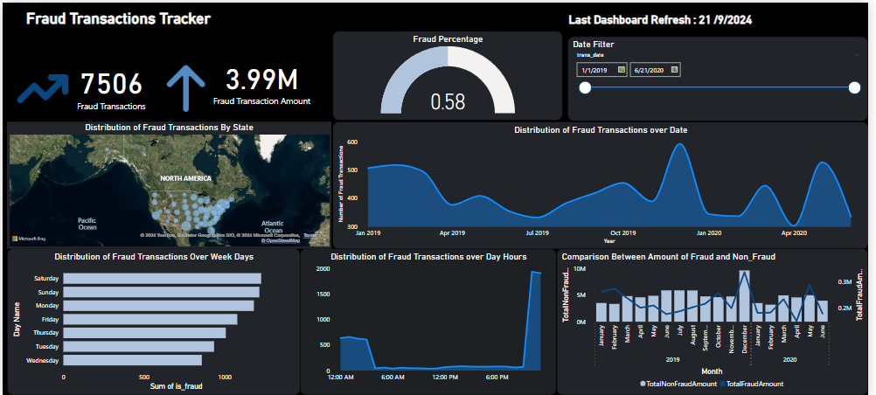
Fraud Transactions Tracker

Slide 11
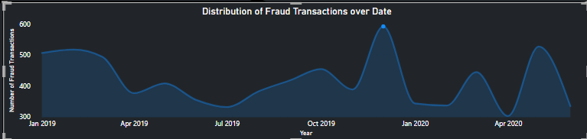
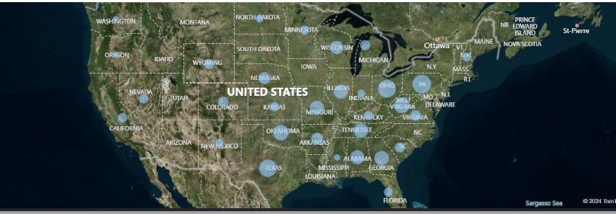
Peak Fraud Transactions Across U.S. States in December 2019
Samsung Innovation campus

Slide 12
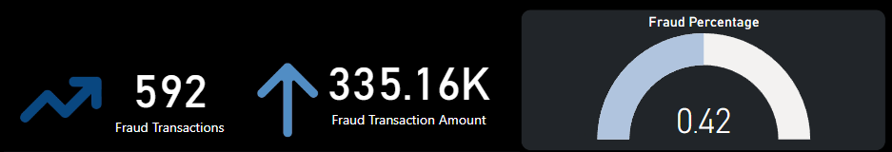
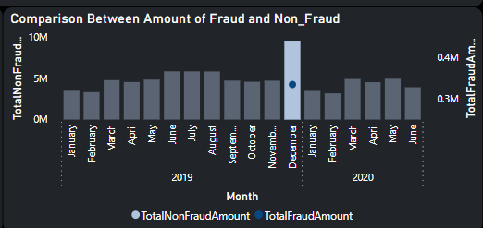
December 2019: Surge in Fraud Transactions and High Fraud Value Impact
Samsung Innovation campus

Slide 13
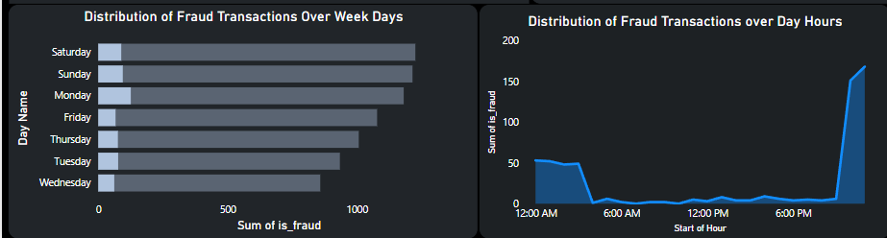
Fraud Transaction Patterns by Day of the Week and Hour of the Day
in December 2019
Samsung Innovation campus

Slide 14
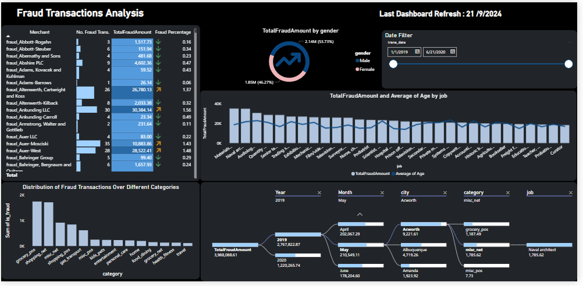
Fraud Transactions Analysis

Slide 15
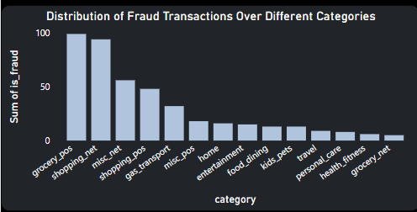
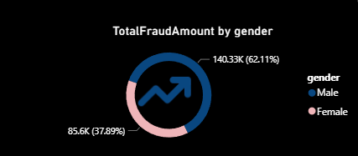
Fraud Distribution Across Categories and Gender-Based Fraud Amounty
in December 2019
Samsung Innovation campus

Slide 16
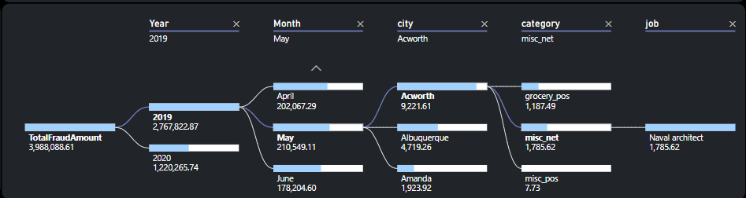
Analyzing Job-Related Fraud Trends: Decomposition Tree Visualization
Samsung Innovation campus

Slide 17
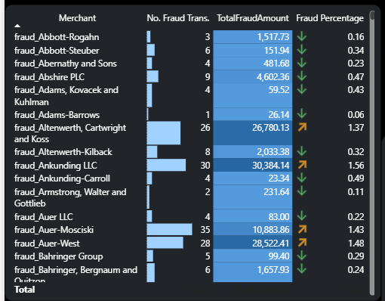
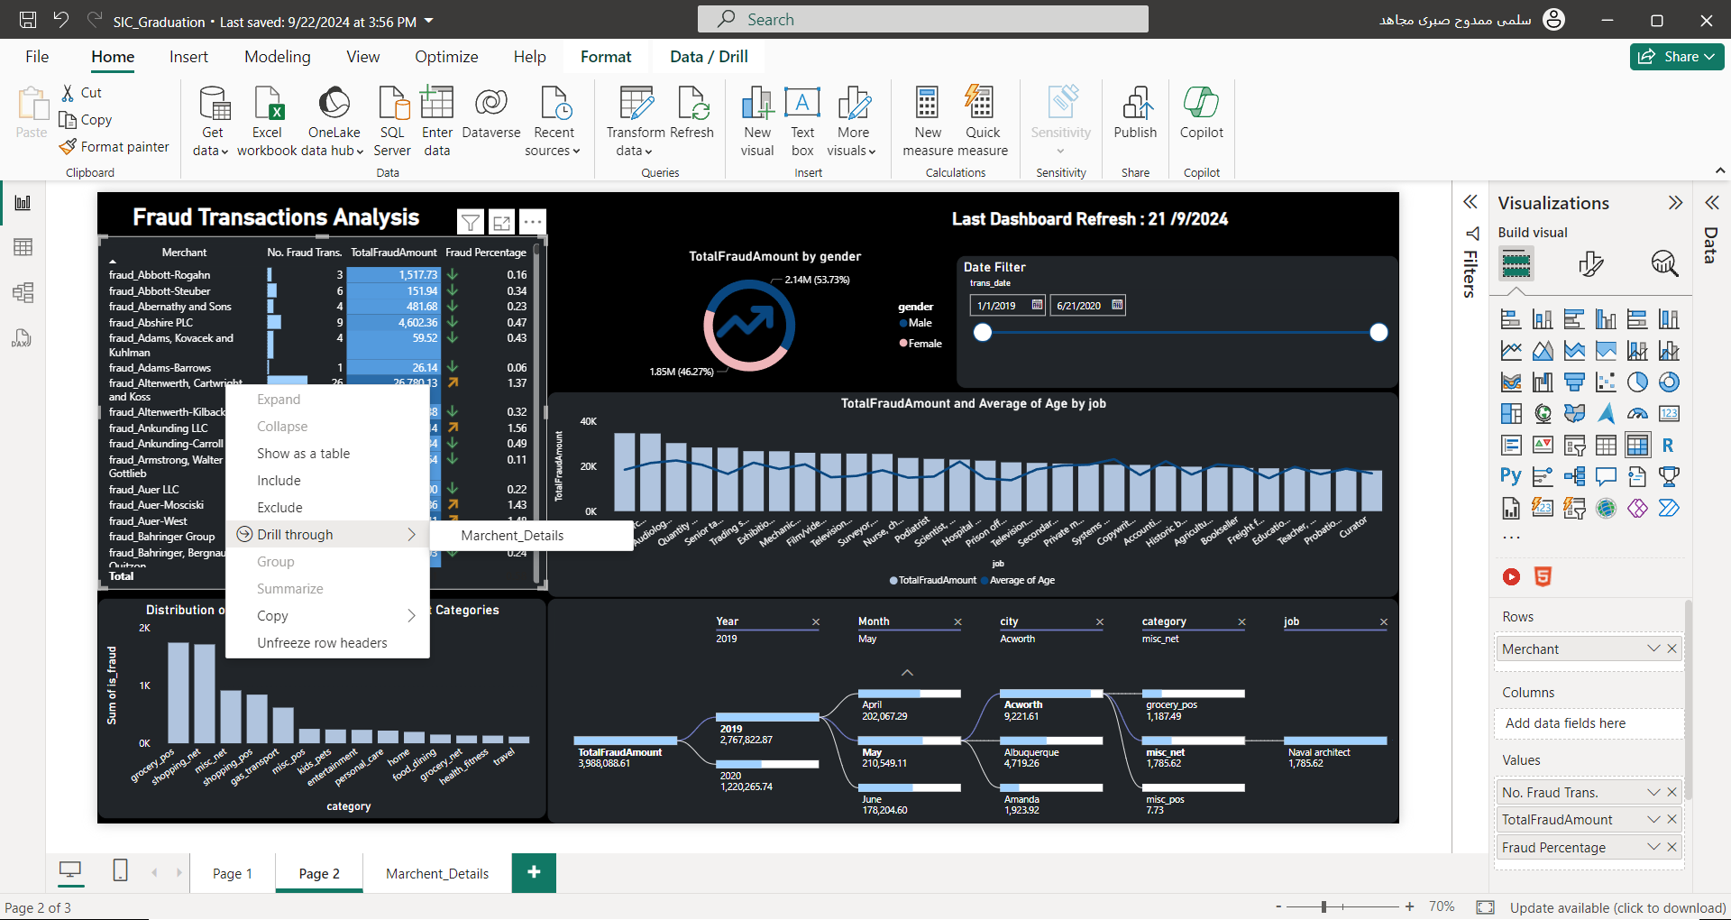
Analyzing Merchant Fraud Data
Samsung Innovation campus

Slide 18
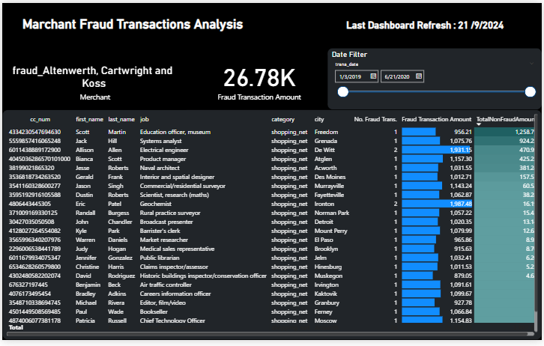
Merchant Details Report
Samsung Innovation campus

Slide 19


MACHINE
LEARNING

Slide 20
EDA

Slide 21
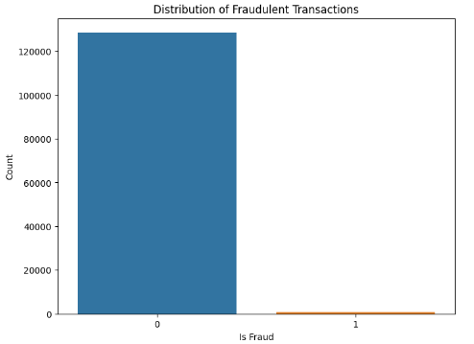
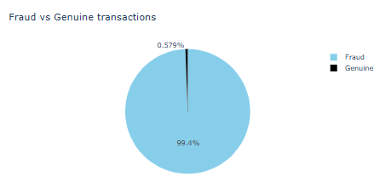
Distribution of Fraudulent Transactions
Samsung Innovation campus

Slide 22
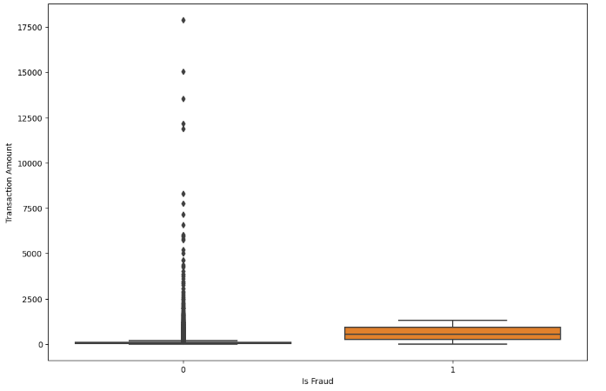
distribution of transaction amounts by fraud status
Samsung Innovation campus

Slide 23
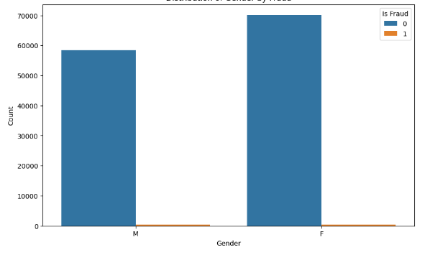
Distribution of Gender by Fraud
Samsung Innovation campus

Slide 24
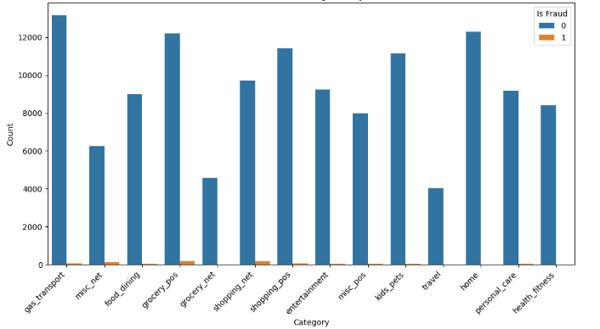
Distribution of Categories by Fraud
Samsung Innovation campus

Slide 25
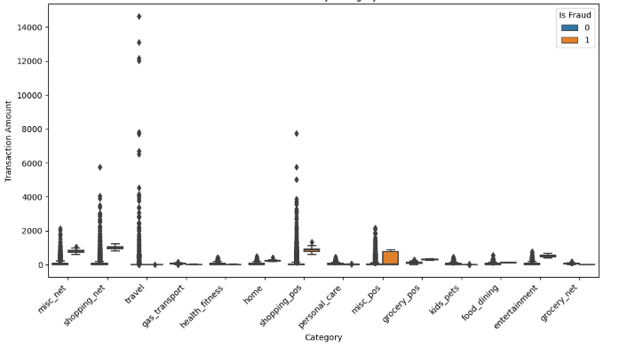
Transaction Amount by Category and Fraud
Samsung Innovation campus

Slide 26
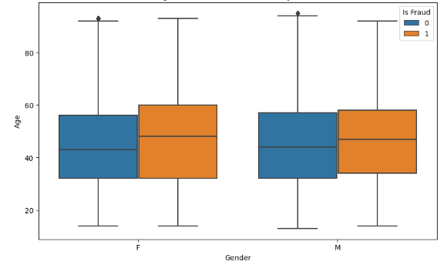
Age and Gender Distribution by Fraud
Samsung Innovation campus

Slide 27
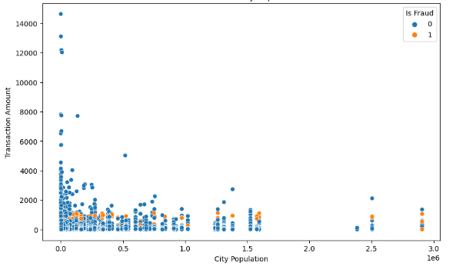
Transaction Amount vs. City Population and Fraud
Samsung Innovation campus

Slide 28
DATA
PREPROCESSING

Slide 29




01
Split train and test data
02
Drop unusable/unnecessary columns
Data Preprocessing
03
Handle data imbalance
These steps focus on preparing data for machine learning by cleaning and transforming it to ensure optimal model performance. The goal is to address irrelevant columns, class imbalance, and varying feature scales before training the model.
04
One-hot encoding
05
Standardize scaling
Samsung Innovation campus

Slide 30
FEATURE ENGINEERING

Slide 31
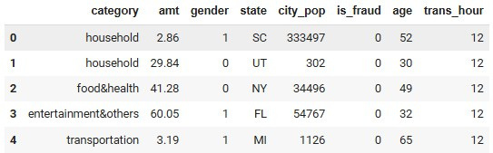
Feature Engineering
The "Age" column was constructed using the "transaction date and time" and the "date of birth"
Samsung Innovation campus

Slide 32
MODELS THAT
WE USE

Slide 33
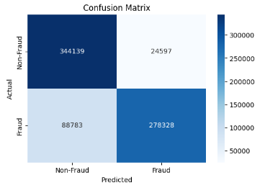
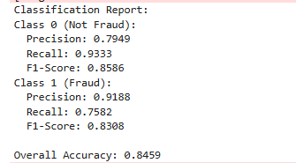
logistic_regression_model
Samsung Innovation campus

Slide 34
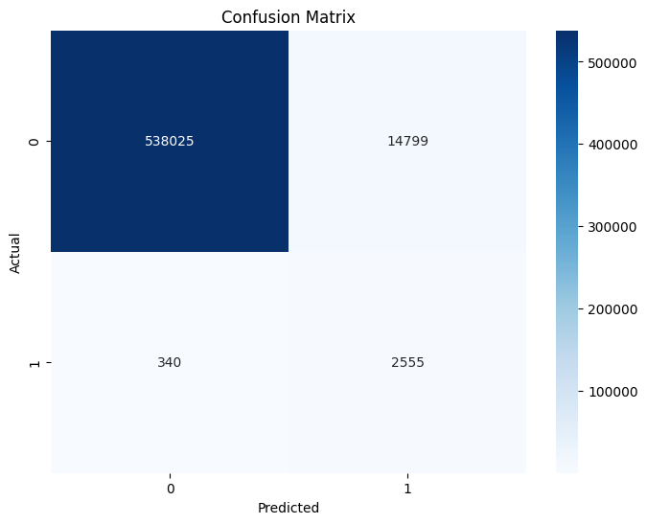
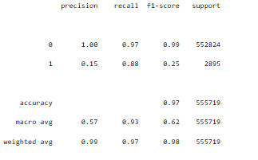
random_forest_model
Samsung Innovation campus

Slide 35
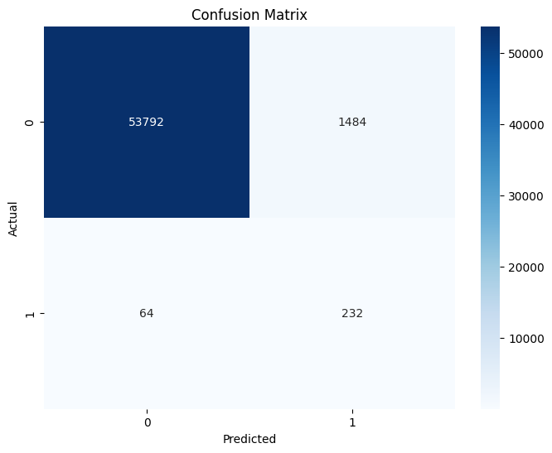
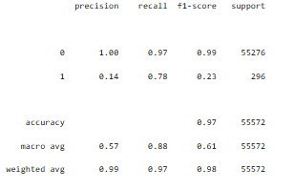
SVM_model
Samsung Innovation campus

Slide 36
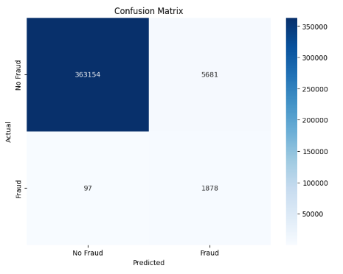
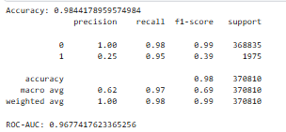
XGboosting_model
Samsung Innovation campus

Slide 37
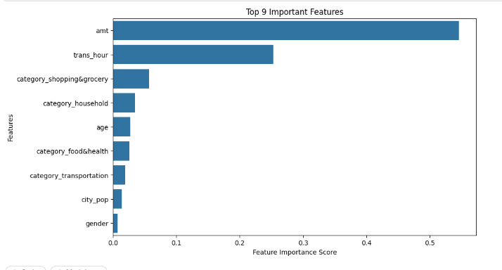
The most important columns that effects
on our models models
Samsung Innovation campus

Slide 38
01
Enhanced Monitoring for High-Risk Merchants
02
Category-Specific Fraud Prevention Strategies
Recommendations
03
Demographic and Occupation-Based Fraud Risk Profiling
These steps focus on targeted interventions to reduce credit card fraud across merchants, customers, and transaction categories.
04
Time-Based Fraud Detection and Real-Time Alerts
05
City and Region-Based Fraud Trends Monitoring
Samsung Innovation campus

Slide 39
01
Enforce multi-layered authentication for both
high-value transactions and high-risk categories
02
Use geolocation data to cross-check whether the location of the customer matches their previous transaction history.
Recommendations
03
Invest in AI-driven predictive analytics to preemptively identify emerging fraud patterns.
These security measures focus on protecting sensitive card data, detecting fraud early, and ensuring strong verification and compliance practices.
04
Replace sensitive card information with unique tokens during transactions to minimize exposure of actual credit card data
05
Use End-to-End Encryption (E2EE): Ensure all transaction data is encrypted from the point of sale to prevent interception by malicious actors.
Samsung Innovation campus

Slide 40


ANY QUESTIONS
??

Slide 41

